Slide 1
Smart Contracts
Architecture and Requirements

Slide 2
Presentation Plan
Implementation Scope in Airlines Industry
High Level Architecture
Development Environments
Applying Business Logic with Smart Contracts
Proof of Concepts

Slide 3
Implementation Scope in Airlines Industry
The following are some of the processes which we can move to a Smart Contract based system:
Case Processing
Maintenance/VM
Transform maintenance logs for better management.
Ensure that parts procured are legitimate and can offer a “virtual copy”, including all details.
Smart Contracts allow the performance of credible transactions without third parties.
Smart Contracts allow the performance of credible transactions without third parties.
Ticketing Process
Loyalty Points
Travelers can get instant value by redeeming them on the spot instead for waiting for a long time to get points settled and accrued to use them.
Using smart contracts associated with tickets, airlines can add business logic and terms & conditions around how the tickets to be sold and used.
We talk about the architecture and requirements in more details in the remaining slides for implementing Case Processing process to a Smart Contracts system as it is closely related to PNR Case Processing process. The same methodology can be implemented across other processes with some changes/adjustments.

Slide 4
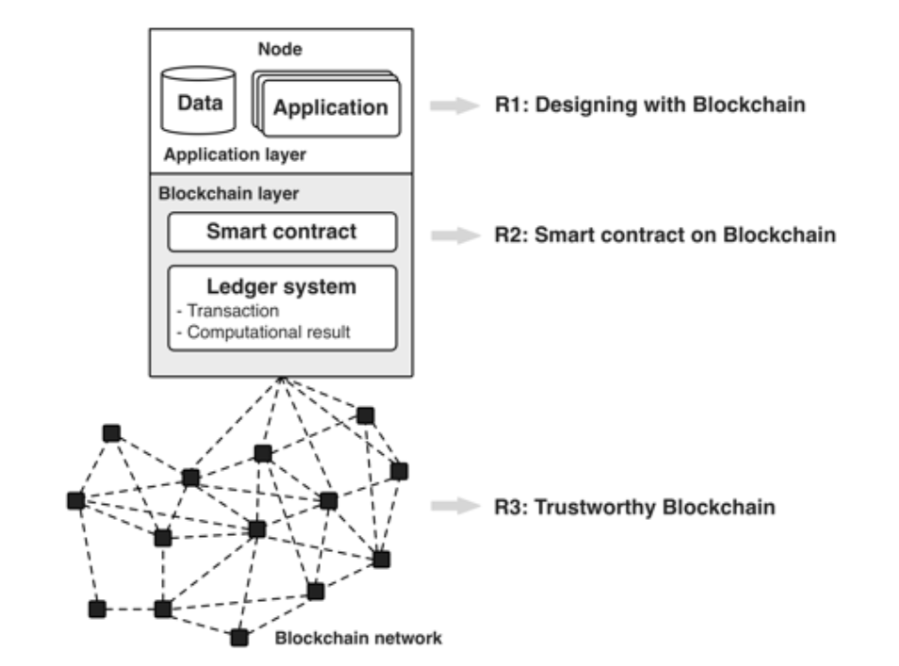
High Level Architecture Overview

Slide 5
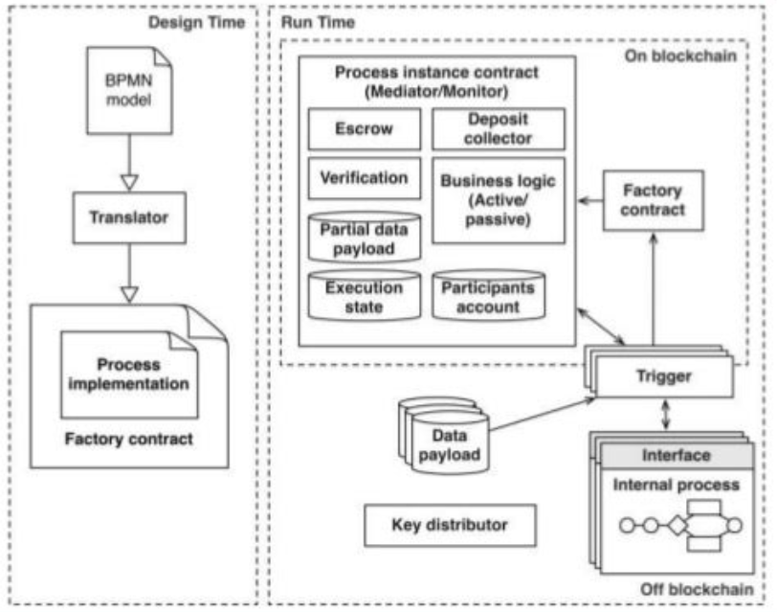
High Level Architecture Business Process Monitoring and Execution
Approach
Translate Business Process Model and Notation (BPMN) to smart contract code.
Triggers act as bridge between Enterprise world and Blockchain.
Smart Contract does the following:
Independent, global process monitoring
Conformance checking
Automatic payment and ticketing
Data transformation
Automated rewards program
Encryption

Slide 6
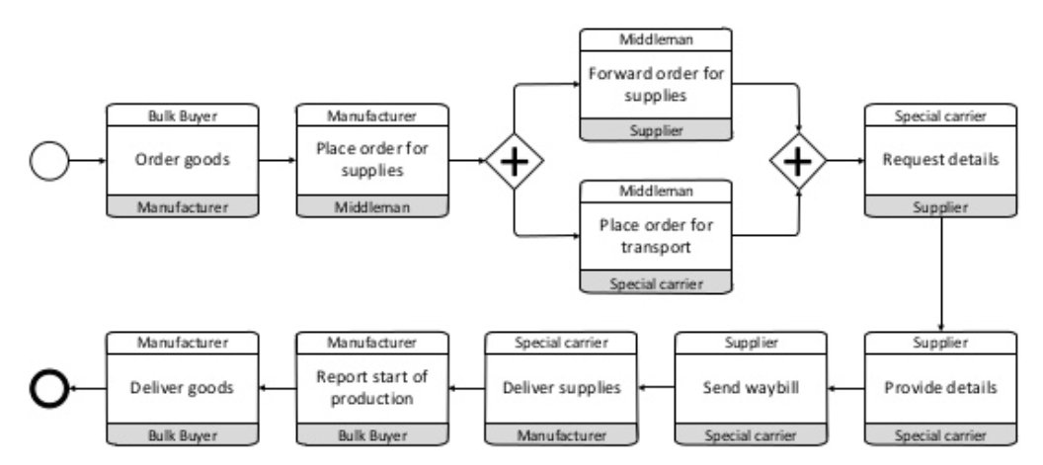
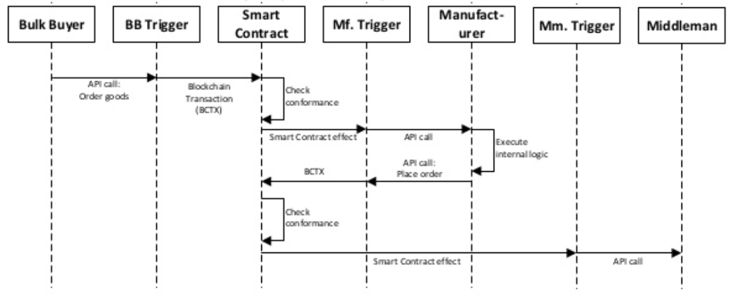
High Level Architecture Business Process Monitoring and Execution- Translation & Instantiation

Slide 7
Development Environments
Environment | NEO | Ethereum
Access Method | NEO-BOA, JSON RPC API, NEX ICO, NEO Smart Contract | Remix/Node Console (NodeJS, ) & Web3/Mist & Ethereum Wallet
Blockchain Technology | NEO Virtual Machines | JavaScript VM inside Remix/TestRPC/Private Ethereum Blockchain
Pythereum
Remix/Node Console & Web3/Mist & Ethereum Wallet
JavaScript VM inside Remix/TestRPC/Private Ethereum Blockchain
User Interface and Development Language | Neo-Python, AngularJS/ReactJS, APIs (Django, Flask, etc.) | Solidity, AngularJS/ReactJS, APIs (Django, Flask, etc.)
Comments | Good Community Support for Developers (City of Zion). Easy implementation of Machine Learning/ Artificial Intelligence based solutions. | Most popular tool to implement Blockchain based solutions. Very strong community support.
Python, AngularJS/ReactJS, APIs (Django, Flask, etc.)
Can be used to explore Ethereum functionalities in Python. Easy implementation of Machine Learning/ Artificial Intelligence based solutions.

Slide 8
Development Environments NEO Blockchain
A Simplified flow of Contract Compilation and Deployment
Smart Contract
(Python code)
Bytecode and ABI
Contract Address
compile
deploy

Slide 9
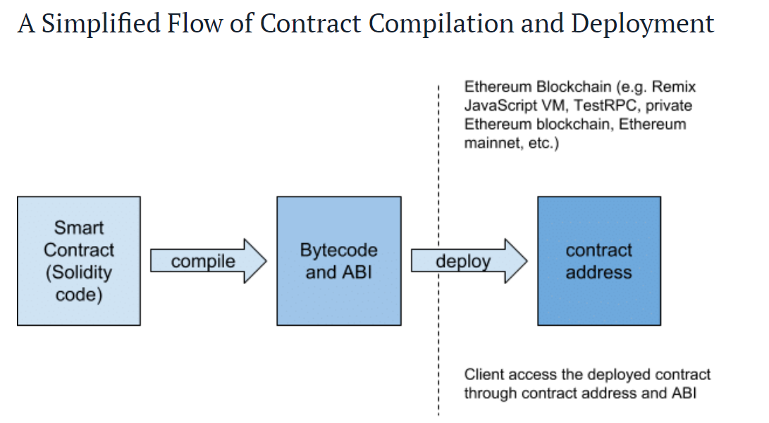
Development Environments Ethereum/Pythereum Blockchain

Slide 10
Applying Business Logic with Smart Contracts
1
4a
Contract Terms
Value Transfer
3
Shared, Replicated Ledger
4b
Settlement
2
Events
1
2
3
4a
4b
Counterparties establish obligations.
Assets put under custody of smart contract.
Conditions for execution.
Event triggers contract execution.
Event can refer to:
Transaction Initiation
Information Received
Terms of Contract dictate movement of value based on conditions met.
Value Transferred to intended recipient as dictated by contract terms.
For digital Assets on-chain (e.g. Bitcoin, Digital Money), accounts are automatically settled.
For assets representated off-chain (e.g. Securities, Cases, Real Estate), value could be moved and settled in off-chain accounts per settlement instructions.

Slide 11
Proof of Concepts
Case 01
Case 02
Objective: Smart Contracts for Case Processing within an organization.
Environment: Ethereum
Development Language: Solidity and JavaScript.
Nodes are various departments/segments/groups within an organization.
Nodes interact with each other for transactions related to some processes.
Objective: Smart Contracts for Case Processing within an organization.
Environment: Ethereum
Development Language: Solidity and JavaScript.
Nodes are various departments/segments/groups within an organization.
Nodes interact with each other for transactions related to some processes.
Sample Code
Sample Code
Please Note:
The PoC/Cases are simple processes and included for demonstration purpose only. Will share a PoC relevant to the SESS process in 2 months’ time. Currently, spending time to get a high level understanding of various sub-processes.

Slide 12
Thank You

